Slide 1
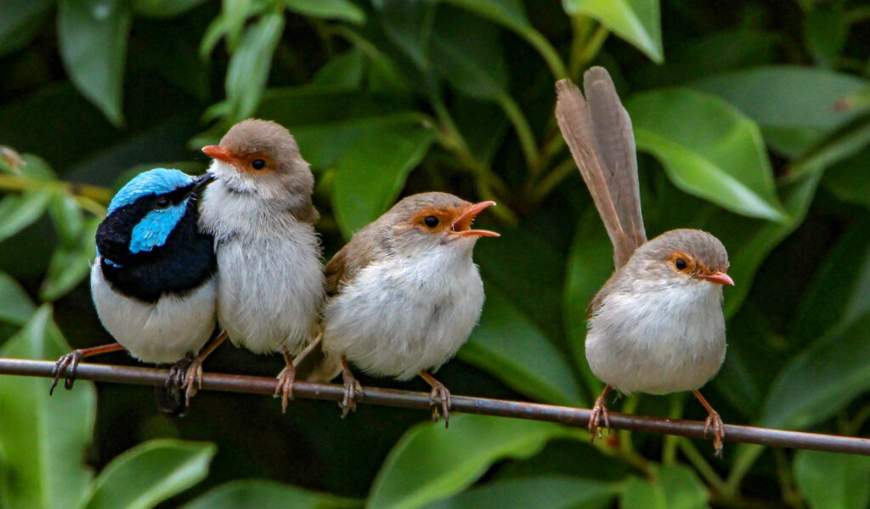
Angela R. Brierly School of Biological Sciences Ecology & Evolutionary Biology Shizuka Lab
What are the fitness consequences of Cooperative Breeding
and how did it evolve?
Photo by Sandra Gallienne via eBird (https://macaulaylibrary.org/asset/86886001)

Slide 2
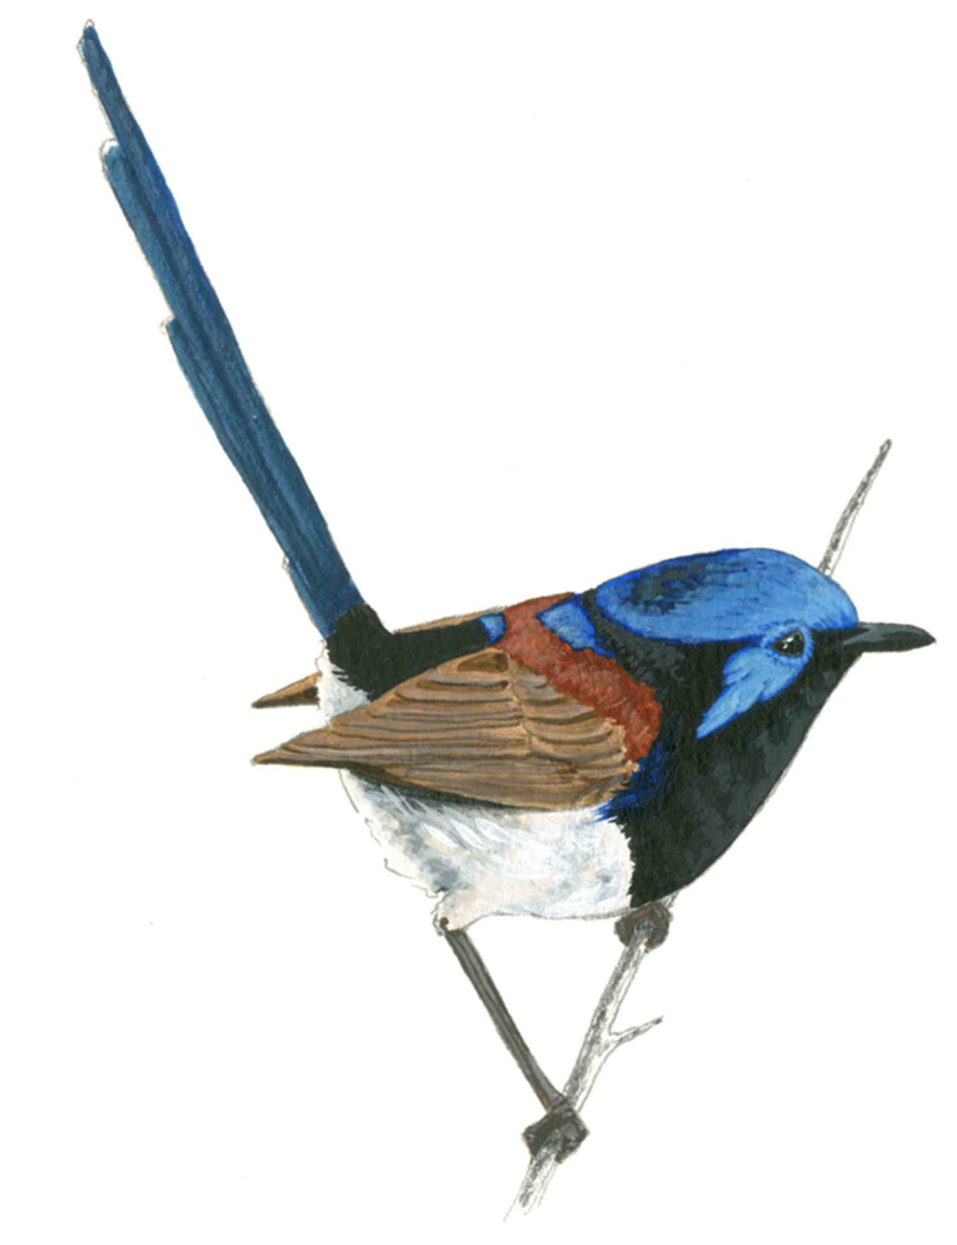
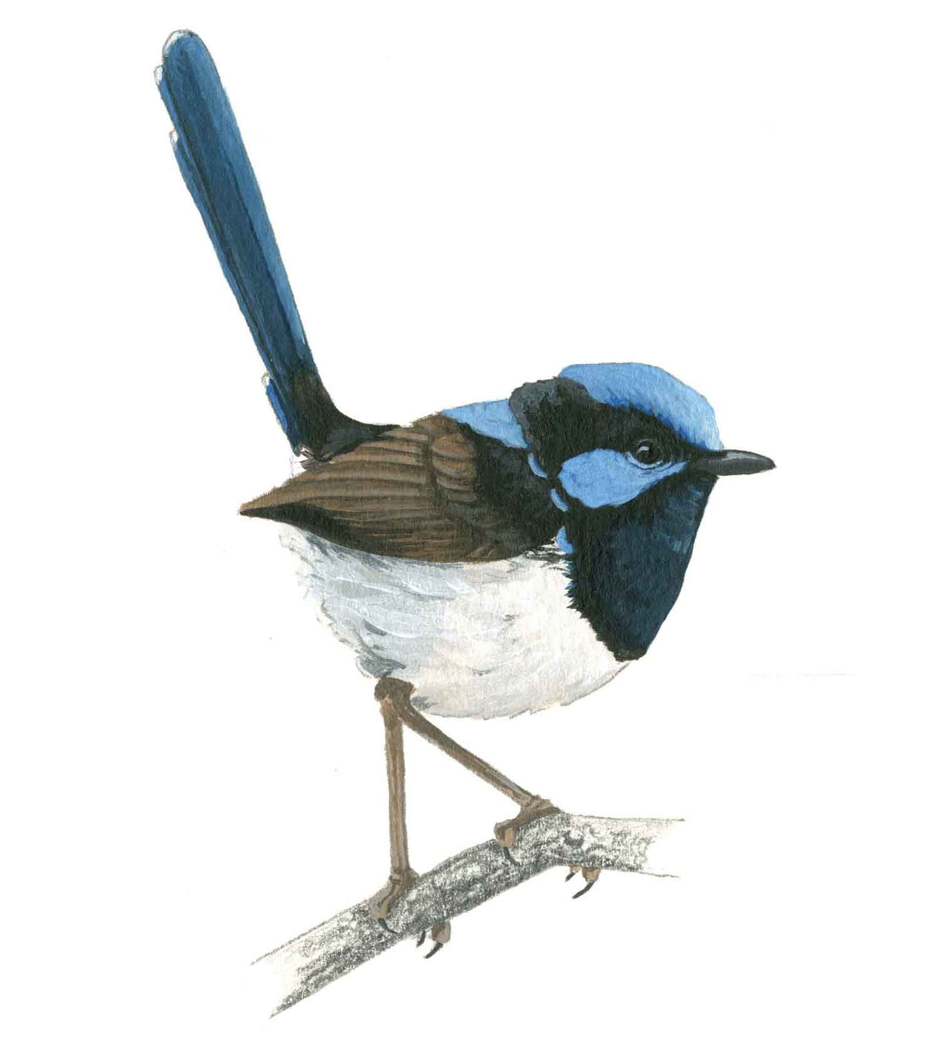
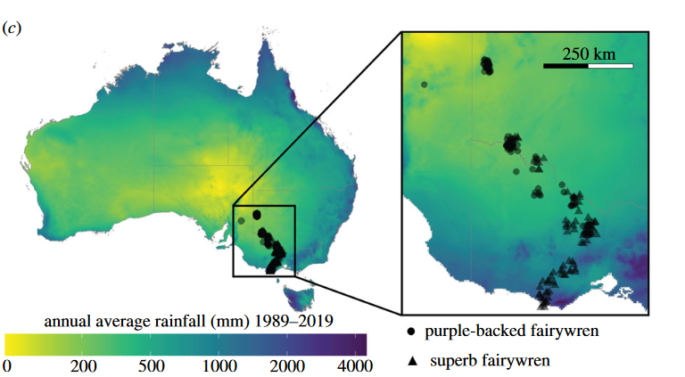
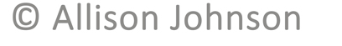
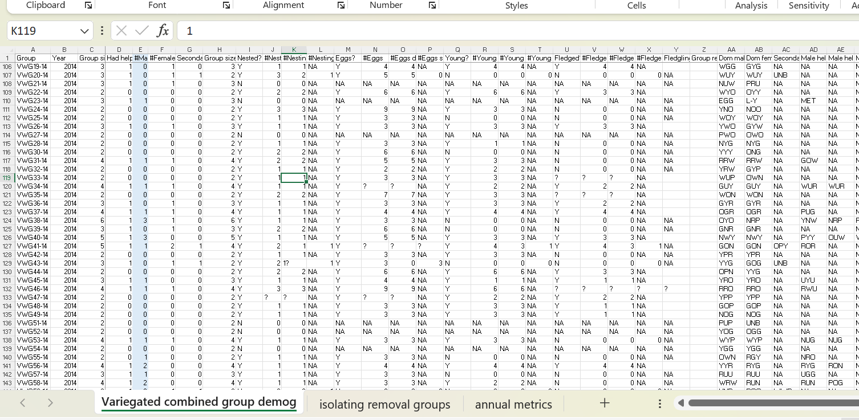
Fairywren Data
Environmental Data
Physiological Needs (resource use)
Fitness (offspring survival)
Demographics (group size & composition)
Social Network
Rainfall
Habitat Quality (insect abundance, plants)
Temperature
Johnson AE, Welklin JF, Hoppe IR, Shizuka D. 2023 Ecogeography of group size suggests differences in drivers of sociality among cooperatively breeding fairywrens. Proc. R. Soc. B 290: 20222397

